Slide 1

Johnson Meitei
@ljohnsonmeitei

Slide 2
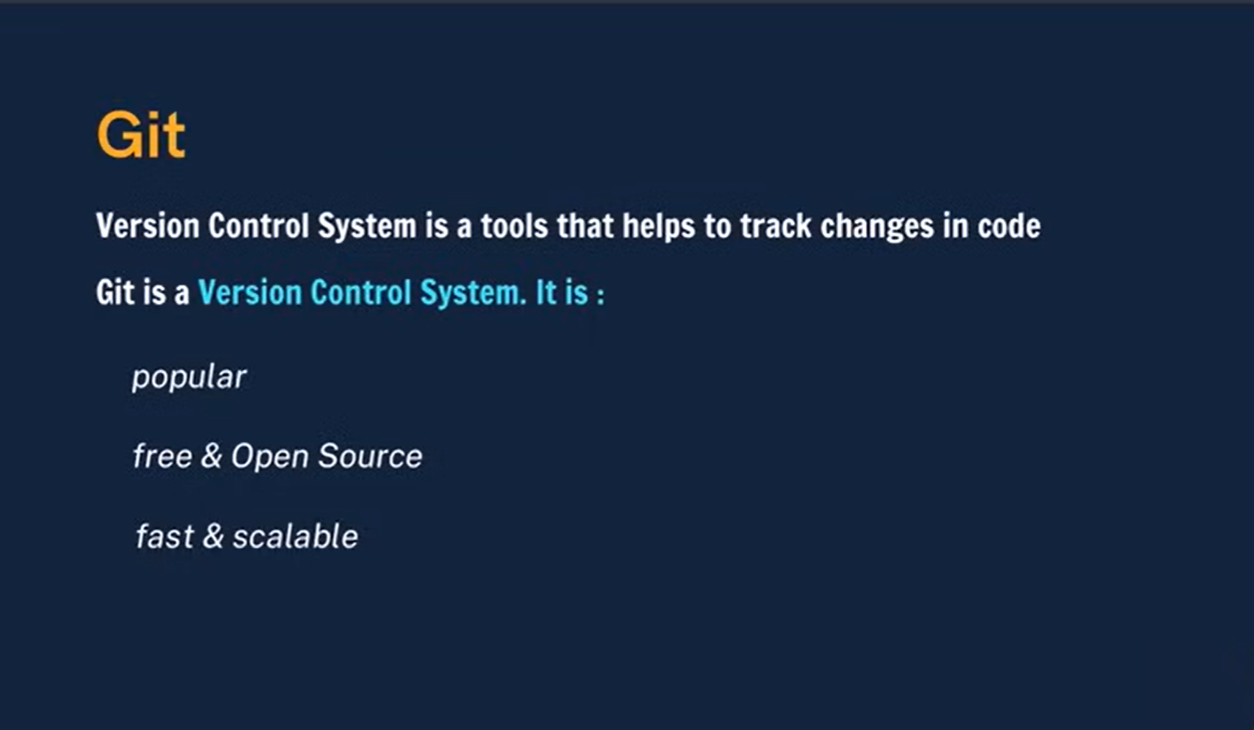
Usage of Git 1. Track code history
2. Collaborate Development

Slide 3
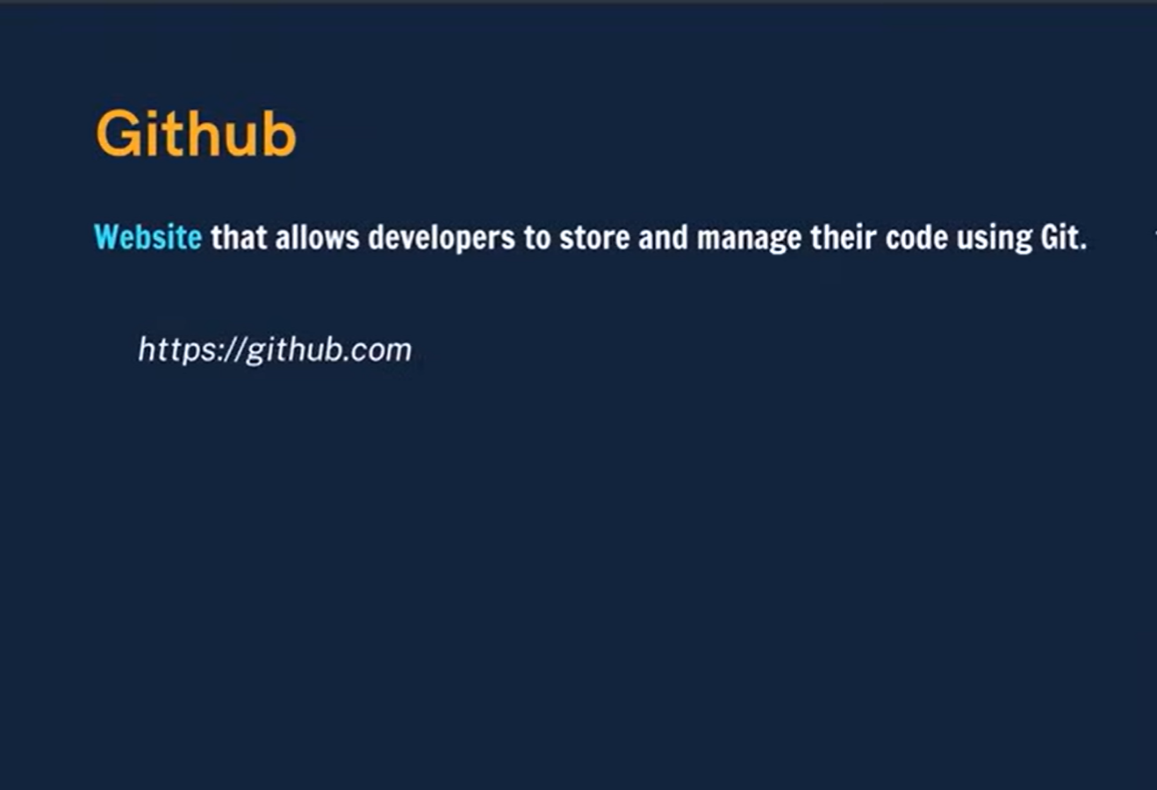
Folder >> Repository Commit >> Save the snapshot of the added code

Slide 4
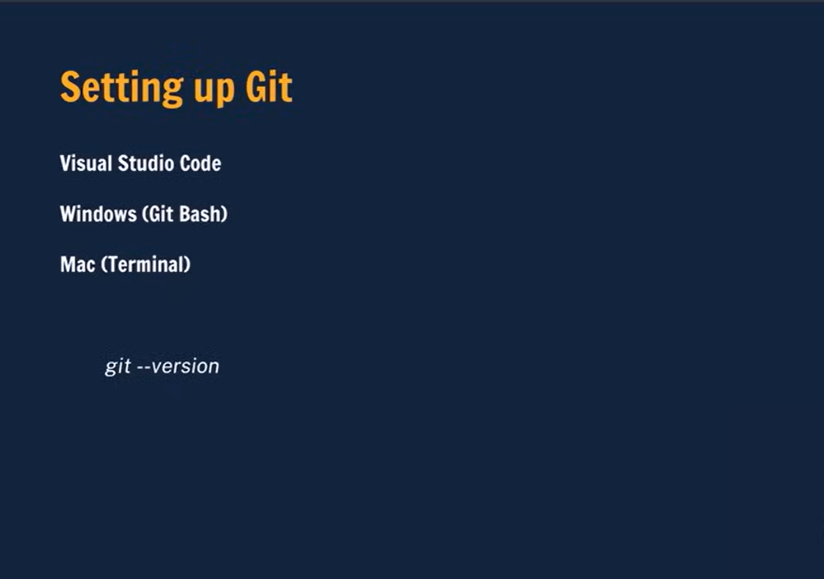

Slide 5
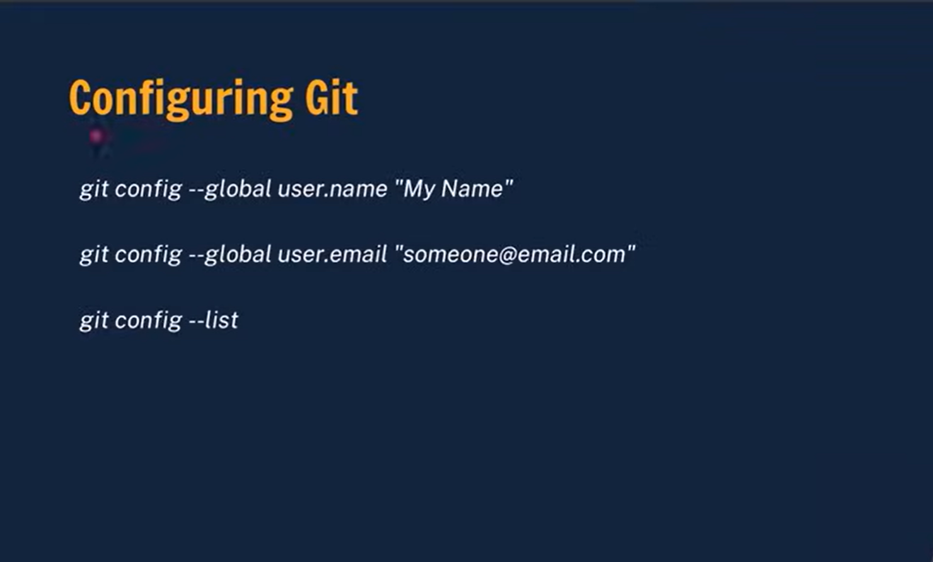
Global Config >> for all the repo
Local Config >> for single repo

Slide 6
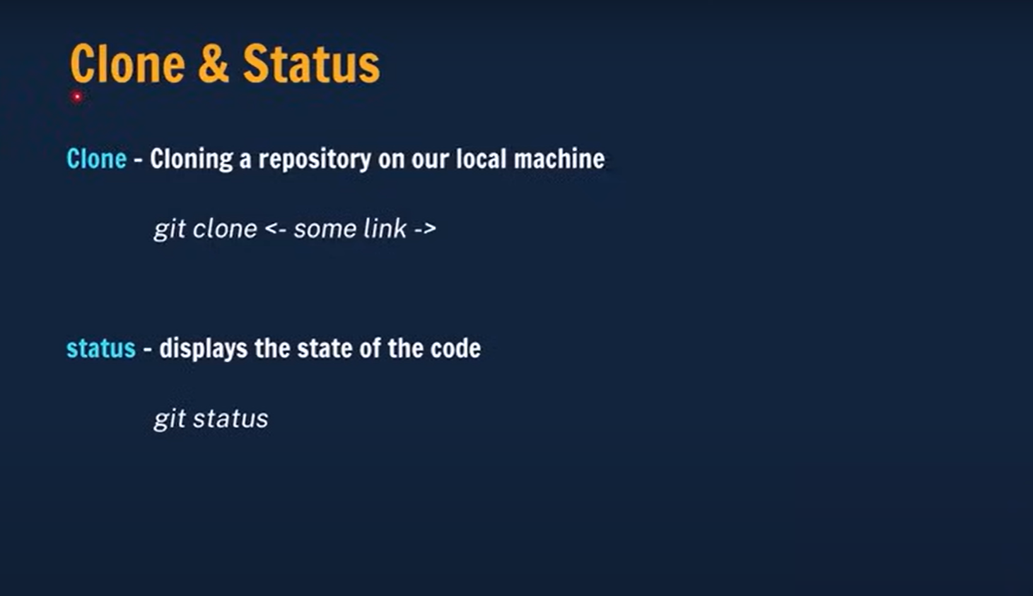
Remote >> github repo
Local >> local repo

Slide 7
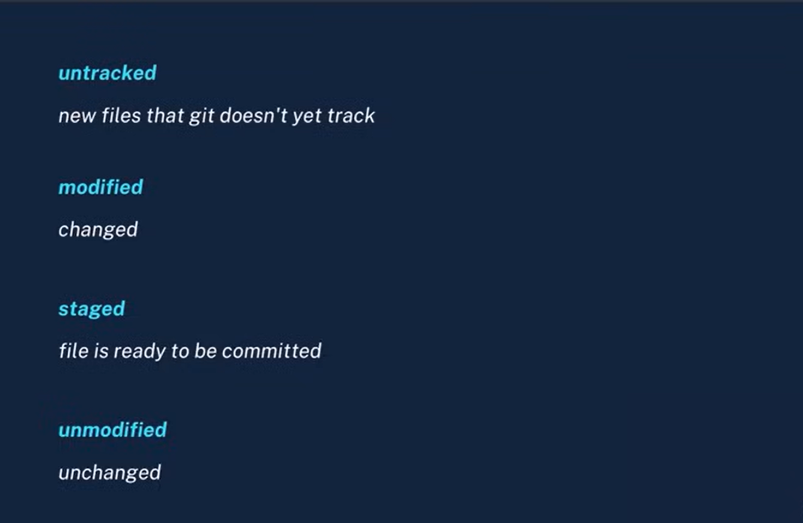
Status Types for git --status

Slide 8
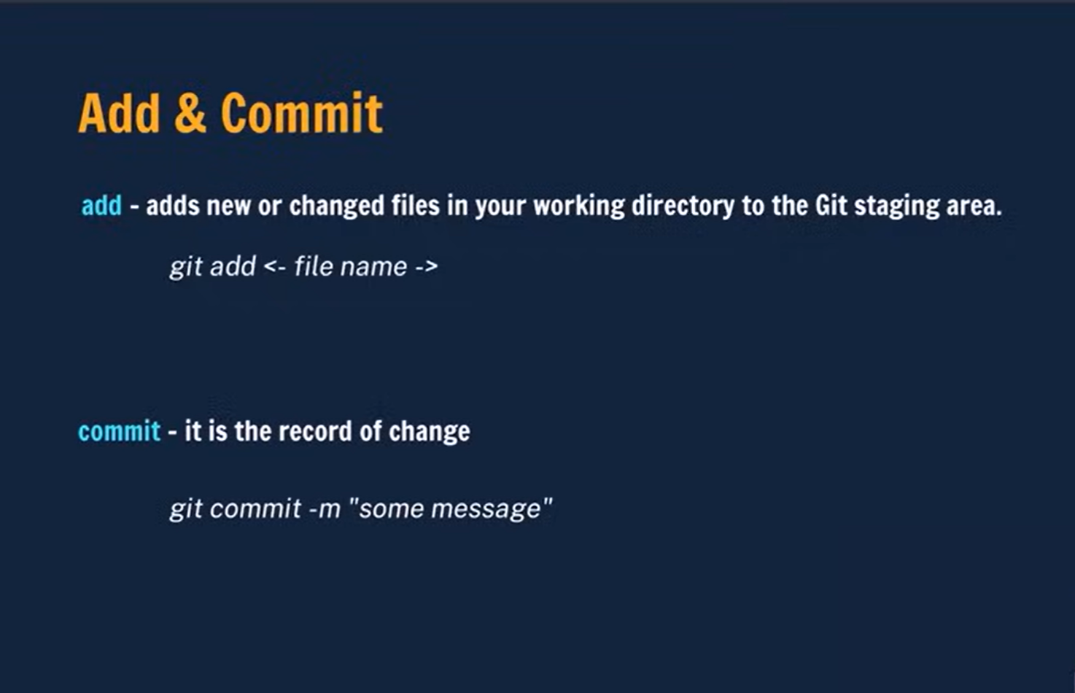
Git add .
Git add readme.md

Slide 9
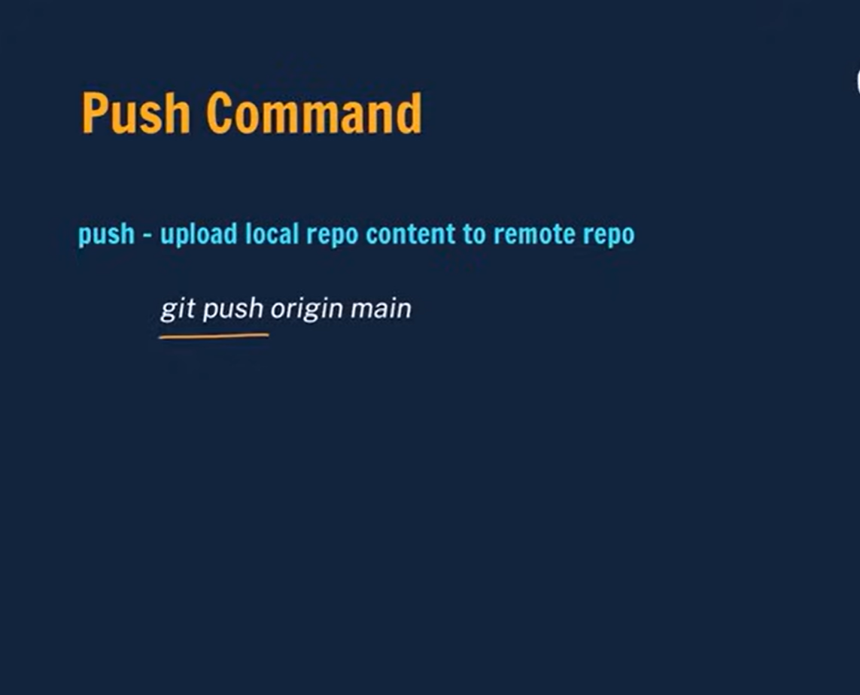
Name of branch
Name of the remote repo
Working Directory > (add)Git Staging > (commit) >> (Push) Git Repo

Slide 10
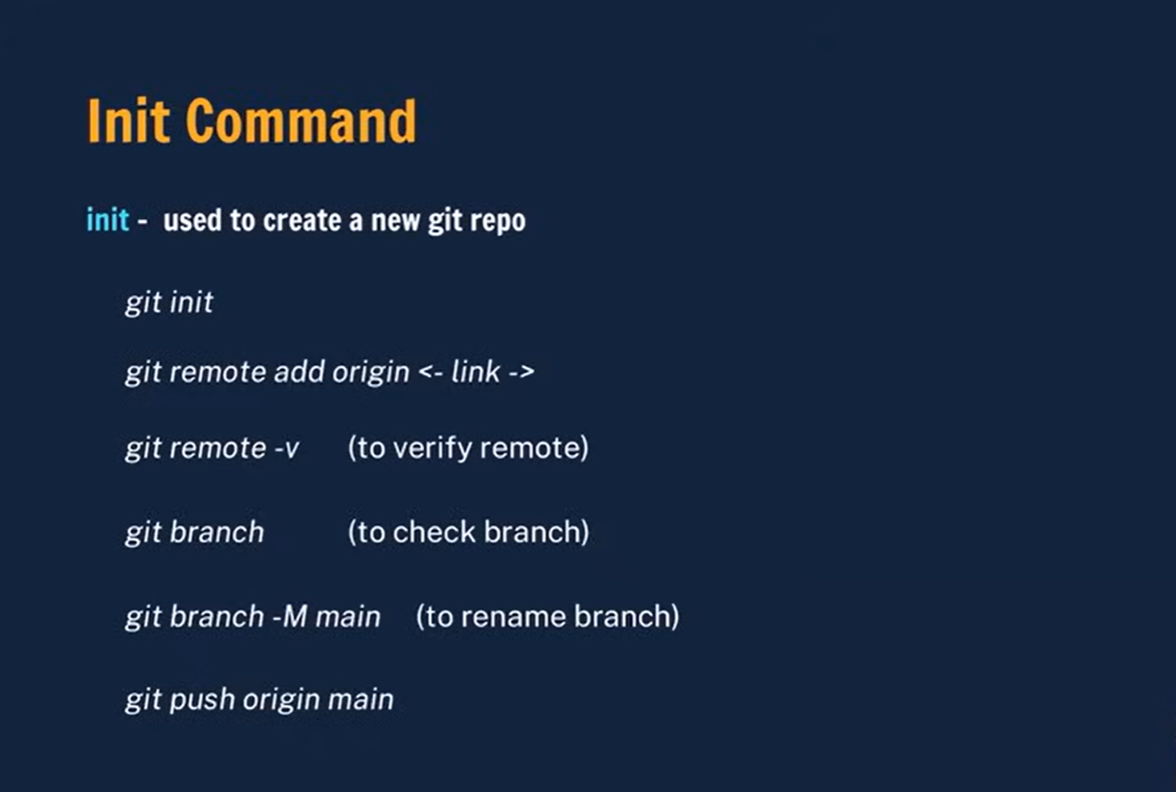
(Git push –U origin Main) >> setting upstream

Slide 11
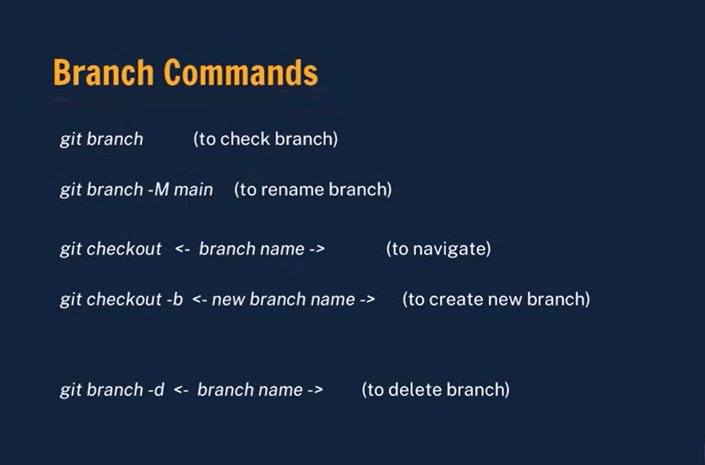

Slide 12
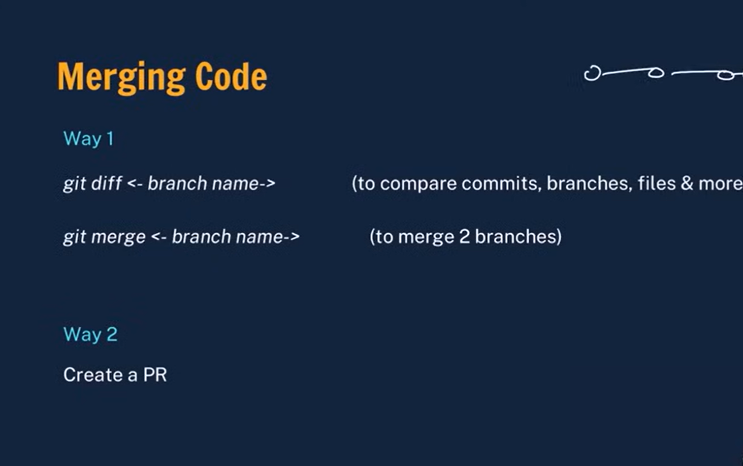

Slide 13
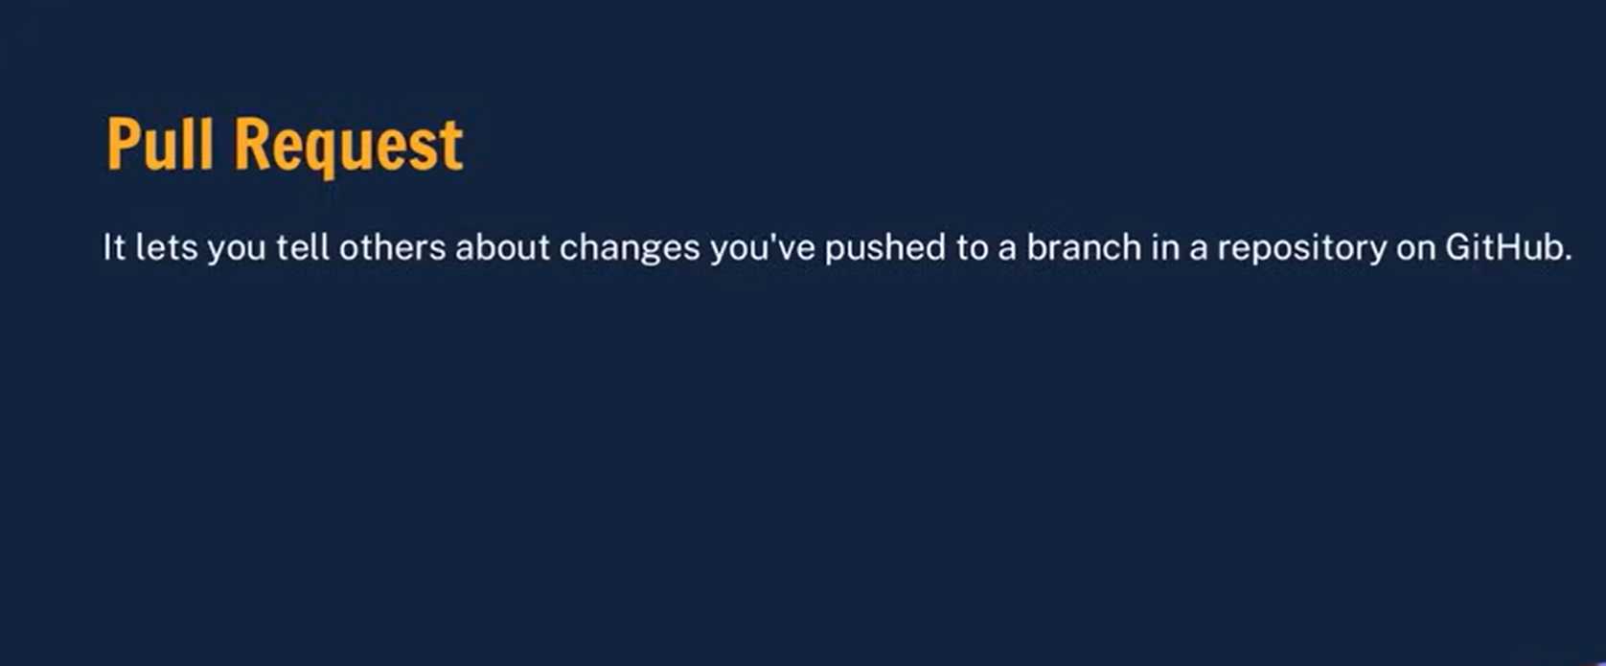

Slide 14
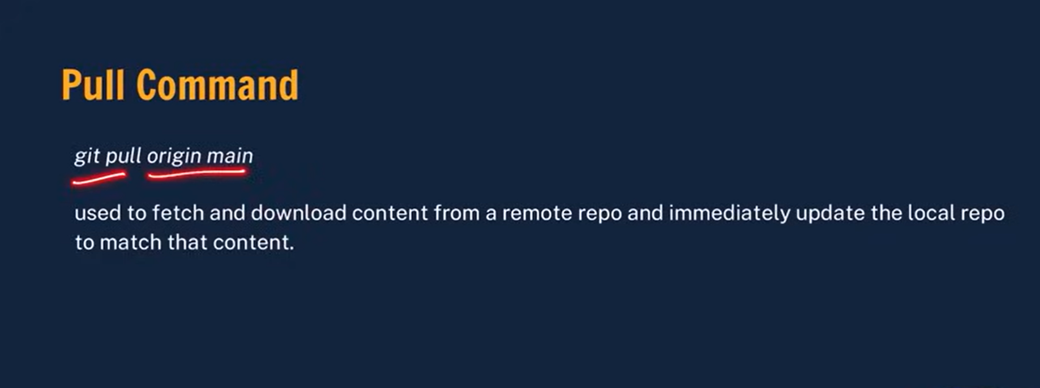

Slide 15


Slide 16
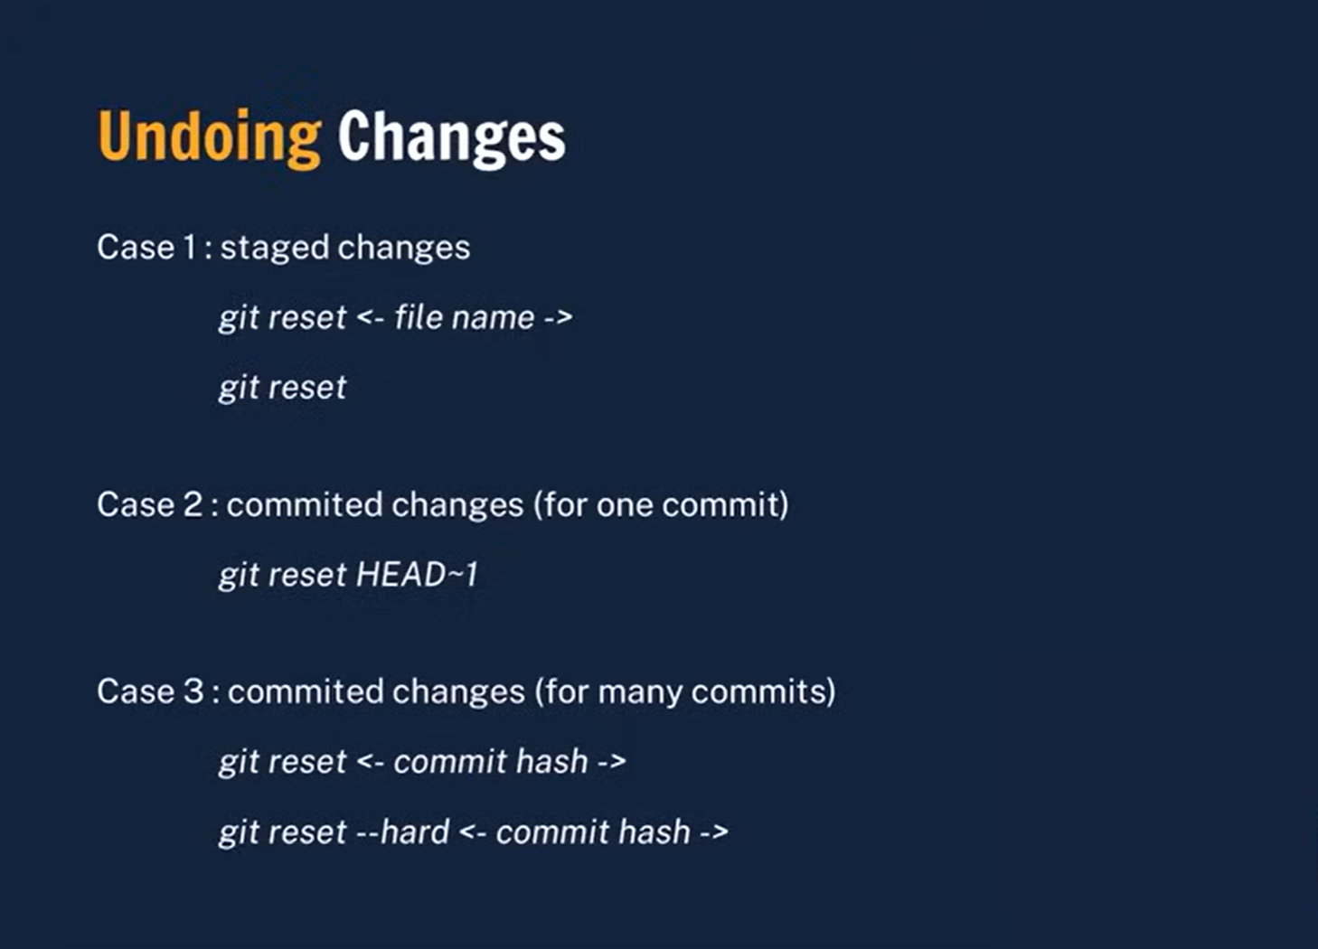
Changing the latest change to -1

Slide 17
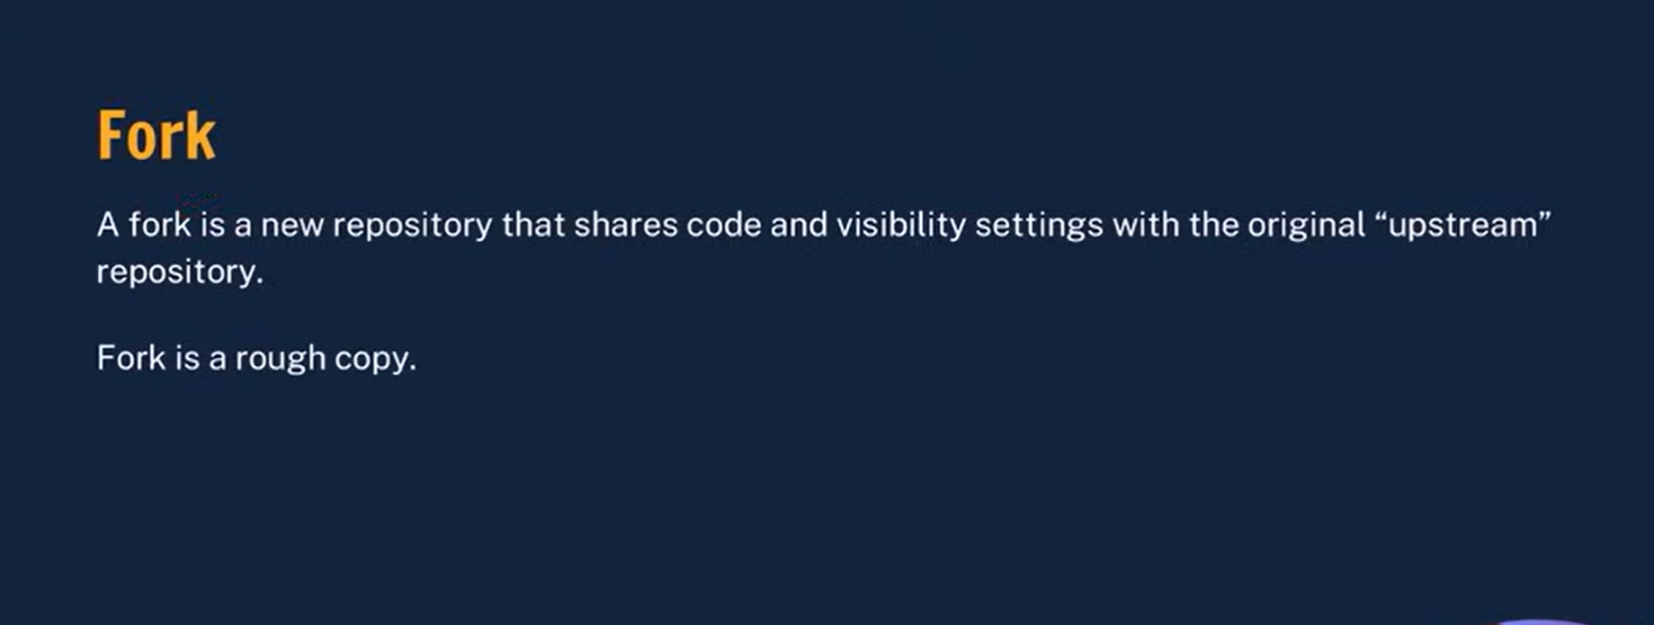

Slide 18
Thank for you attending the session ….

